Slide 1
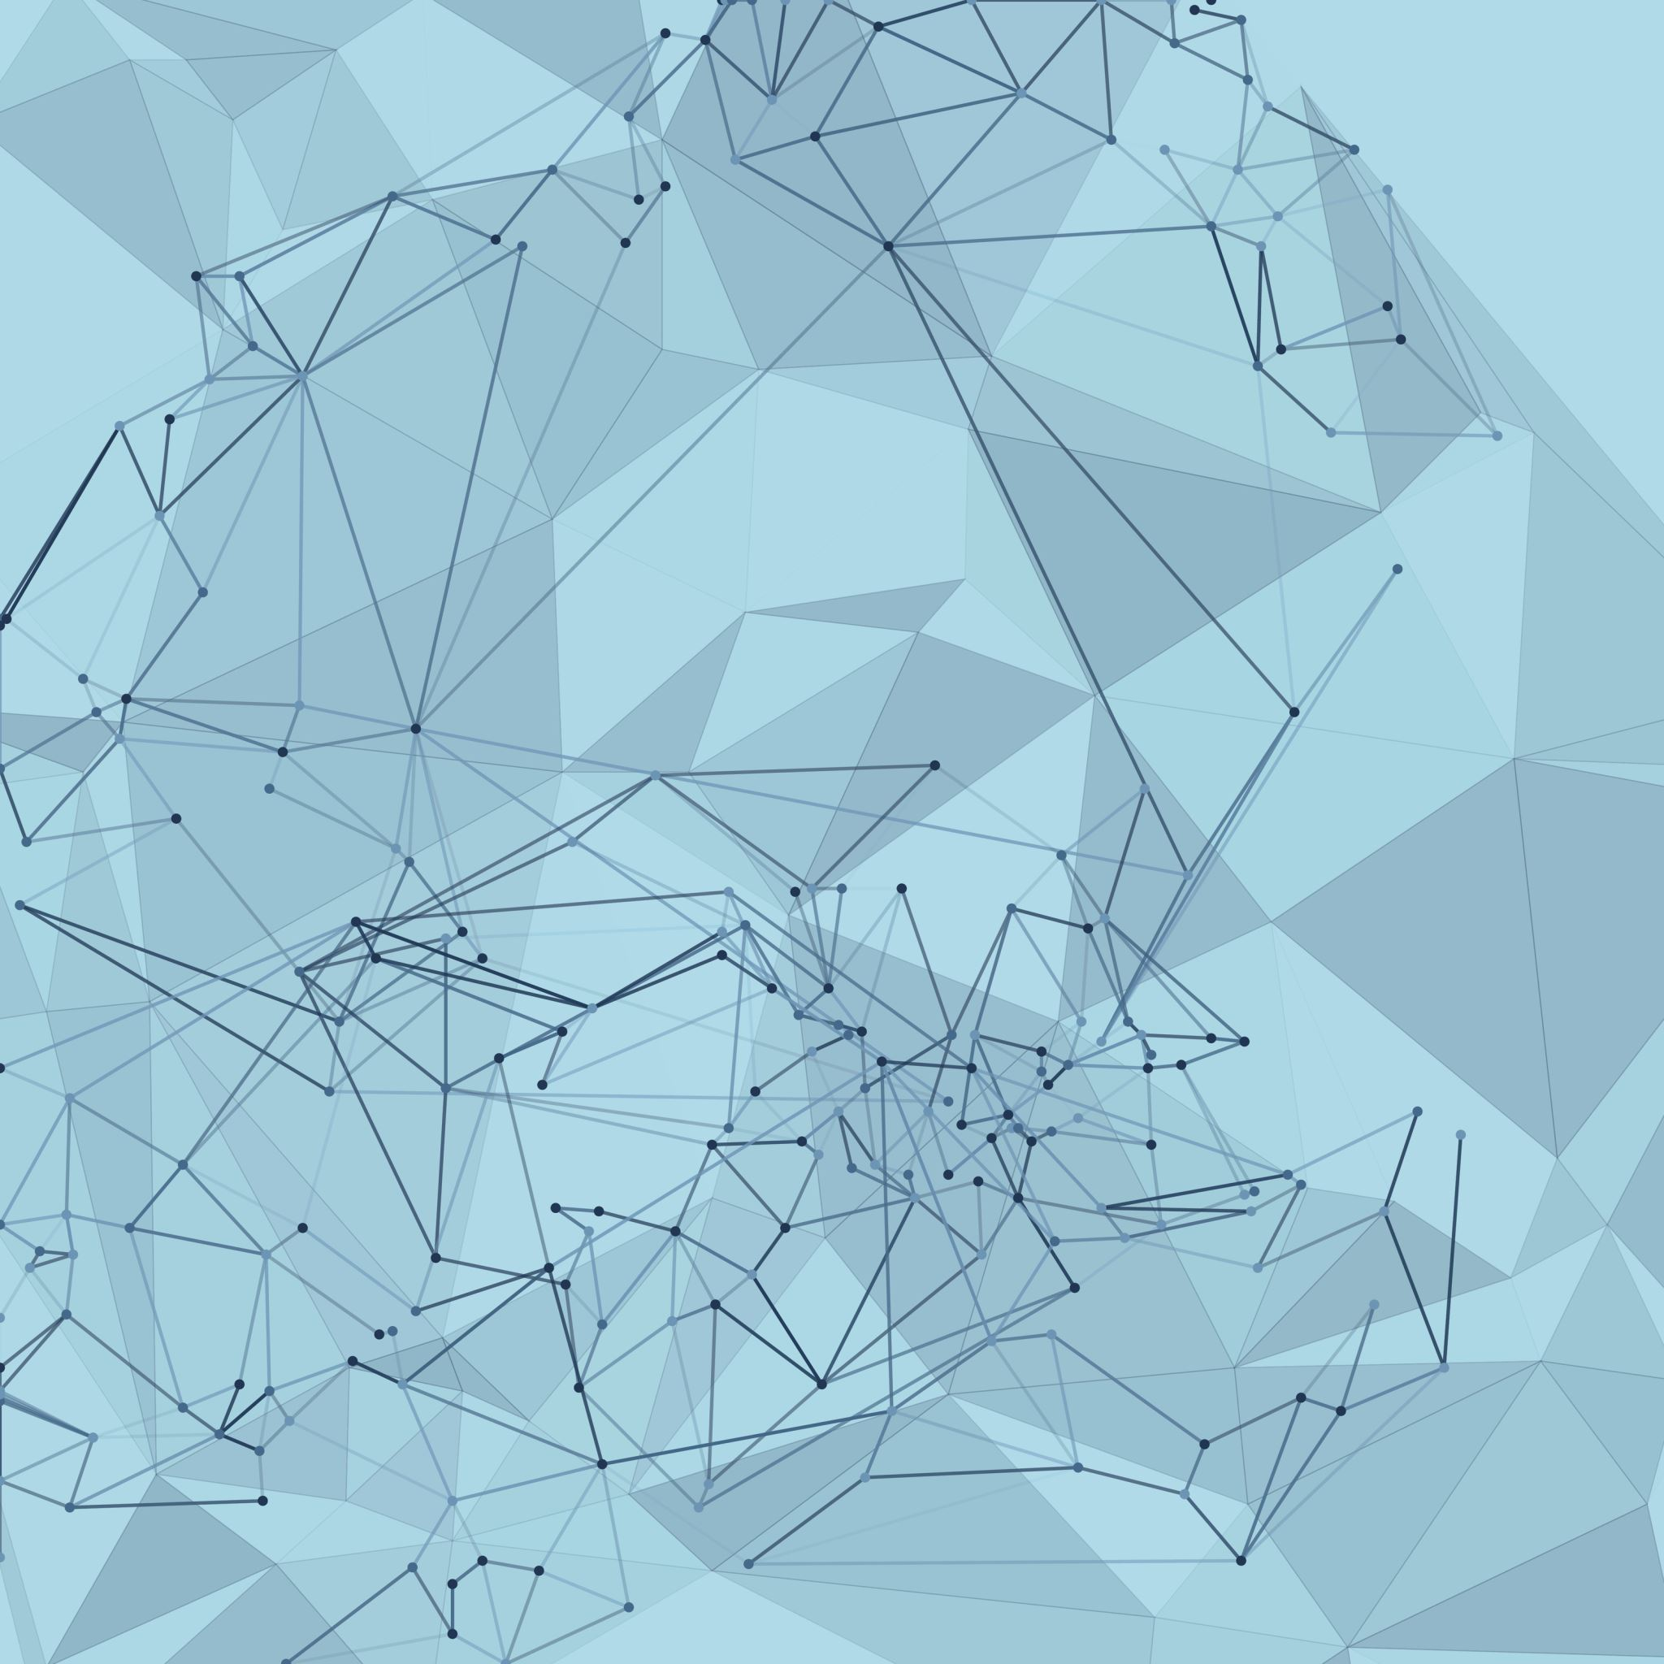
Agile Presentation
Joey Quinata

Slide 2
Agile Roles
Product Owner
Scrum Master
Development Team
Owns the product vision, manages the backlog, and ensures the team is always working on the highest-value features.
Helps the team stay focused and productive by removing blockers, guiding the team in following Scrum, and promoting a culture of continuous improvement.
Helps the team stay focused and productive by removing blockers, guiding the team in following Scrum, and promotes continuous improvement.
Notes:
The Product Owner is the person who sets the vision for the product. They create and manage the product backlog and make sure the team is always focused on delivering the features that bring the most value to the customer. During the SNHU Travel project, acting as the Product Owner helped me see how important it is to prioritize the right work and keep communication clear between stakeholders and the team.
The Scrum Master is not a manager, but more of a coach and facilitator. They make sure the team follows Scrum practices and help remove any obstacles that could slow the team down. In my Scrum Master role, I learned how important it is to support the team’s work without micromanaging. It is about encouraging self-organization and keeping the team moving forward smoothly.
The Development Team includes the people who actually build the product. They are cross-functional, meaning they have all the skills needed to deliver working software each sprint. Developers, testers, and designers are all part of this team. During my time as a Developer and Tester, I saw how important it is for the team to collaborate closely, share knowledge, and stay flexible.
All three roles are equally important, and when they work well together, they create a strong, self-organizing team that can adapt quickly and deliver real value to the customer.

Slide 3
Rather than designing everything upfront, Agile teams design just enough to start building. Then they create working increments during each sprint.
At the end of every sprint, working software is delivered. The team gathers feedback, updates priorities, and plans for the next cycle.
Planning
Design & Building
Testing
Release and Review
Retrospe-ctive
In Agile, planning is not a one-time event. It happens before each sprint and includes backlog refinement, estimating effort, and setting sprint goals.
Testing is integrated into every sprint, not saved for the end. Testers work side by side with developers and Product Owners.
Teams pause after each sprint to reflect on what went well and what could improve.
Notes:
In Agile, the traditional phases of the software development life cycle happen differently than they do in Waterfall. Instead of moving through each phase one time in a straight line, Agile spreads the phases across multiple sprints and keeps them flexible.
Planning in Agile happens at the beginning of each sprint. Teams set goals based on the highest priorities in the backlog, rather than trying to plan every detail up front. This way, if the project's needs change, the team can easily adjust without starting over. Design and development are done in small pieces. Teams design just enough to begin building and then keep improving as they deliver working versions of the product. There is no need for a complete final design before writing code.
Testing is built into every sprint.
It is not saved for the end like in Waterfall. Teams create test cases early, test features as they are built, and fix issues quickly before they grow into bigger problems.
At the end of every sprint, there is a review. Teams demonstrate the working product to stakeholders, gather feedback, and plan the next steps. Frequent reviews keep the work aligned with what users actually need.
Finally, retrospectives are held after each sprint. The team talks about what went well, what could improve, and how to make the next sprint even better. This continuous improvement is a big part of what makes Agile strong.
When working on the SNHU Travel project, I saw firsthand how overlapping these phases kept the project moving forward, even when changes came up. Agile made it easier to stay flexible, deliver small results often, and learn from every cycle.

Slide 4
Agile vs. Waterfall
Waterfall Approach
Agile Approach
Planning | Heavy upfront planning
Development | One big push after design
Handling Change | Difficult and costly
Feedback | Late (after delivery)
Planning | Ongoing planning each sprint
Development | Incremental development
Handling Change | Built to adapt quickly
Feedback | Early and continuous
Notes:
Throughout the modules and working on the SNHU Travel project and what I learned from Cobb and the Scrum Guide, it became clear why Agile works better for flexible projects. Waterfall depends heavily on getting every requirement perfect at the start, which can make it very hard to adjust if something changes along the way.
If had used a traditional Waterfall approach for SNHU Travel, the shift to focusing on wellness travel would have caused major setbacks. We would have had to revisit our designs, rewrite plans, and rework much of what was already done.
Using Agile, if the problem arises, you simply update the backlog, re-prioritize the new user stories, and kept moving forward with the new theme. Agile's flexibility allowed us to adapt quickly and still deliver a high-quality product without wasting time or effort. Cobb emphasizes that Agile welcomes change, even late in development, and the project really proved that was true.

Slide 5
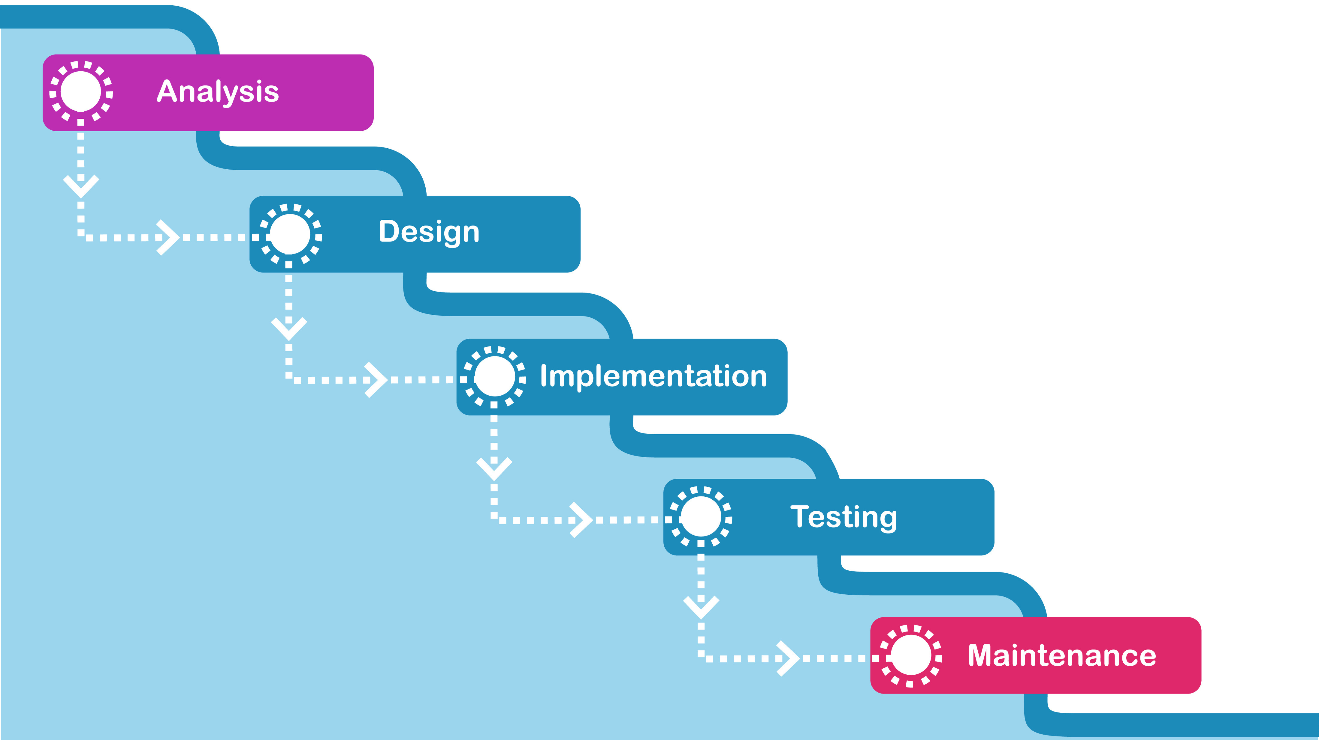
Waterfall approach
Upfront planning makes change slow, expensive, and disruptive.
Late delivery risks building the wrong product with no early feedback
Notes:
If we had used a Waterfall approach for the SNHU Travel project, we would have spent a huge amount of time at the start creating detailed plans for the whole app. Every feature, every screen, and every piece of content would have needed to be locked down before we even started building anything. When the project focus shifted to wellness travel, it would have caused major problems. In Waterfall, changing the plan halfway through means going all the way back to the requirements phase. We would have had to redo designs, rewrite documents, and ask for new approvals. That would have caused serious delays, more costs, and a lot of frustration for the team.
Working in Agile made that change manageable. In Waterfall, it could have threatened the entire project timeline.
Another big difference would have been how we delivered the project. In Waterfall, the team would work for months without showing a working version of the app to stakeholders. Only at the very end would we deliver the finished product.
If we had taken that approach, we might have built something that no longer fit the customer’s needs. For example, if we built everything around general travel destinations without knowing the company had shifted its branding toward wellness, we would not find out until the very end when it was too late to easily fix.
Agile made it possible to deliver small pieces of working software at the end of each sprint. Even though this was a class project, it showed me how much better it is to get feedback early and often. In Waterfall, we would have missed the opportunity to pivot early and deliver something that matched the user's real expectations.

Slide 6
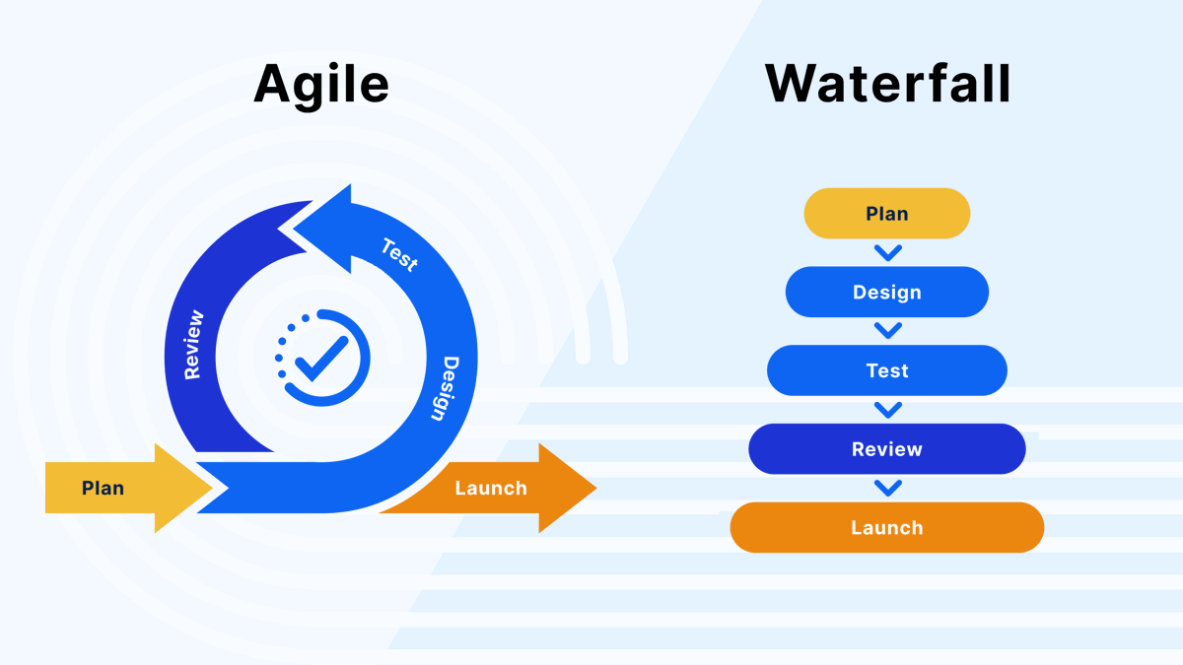
Final Recommendation
Move forward with adopting Scrum-Agile company-wide
Pilot Agile on a few more projects before full rollout
Provide role-specific training for Scrum Masters and Product Owners
Use tools like JIRA for team coordination and transparency
Focus on teamwork, adaptability, and continuous improvement
Notes:
After working through the SNHU Travel project and learning more about Scrum and Agile, I believe ChadaTech should move forward with transitioning more of its teams to a Scrum-Agile approach.
One of the biggest things I noticed is how Agile creates space for flexibility. When priorities shift or customer needs change, Agile teams are able to adjust without losing momentum. This would help ChadaTech deliver better products faster, especially in industries where customer feedback is critical.
I also saw firsthand how Agile improves teamwork. It encourages open communication, early testing, and constant feedback, which helps teams stay aligned and solve problems sooner rather than later. Tools like JIRA and practices like daily standups, sprint planning, and retrospectives make it easier for everyone to stay connected and transparent about progress.
Of course, moving to Agile is a change, and it would take time for teams to adapt. I would recommend continuing to pilot Agile on a few more projects first, offering training for key roles like Scrum Masters and Product Owners, and making sure leadership is ready to support the change.
Based on what I experienced, Agile is not just a process shift, it would be a cultural improvement for ChadaTech. It encourages collaboration, flexibility, and continuous learning, all of which are needed for long-term success.

Slide 7
References
Cobb, C. G. (2015). The project manager’s guide to mastering agile: Principles and practices for an adaptive approach. Wiley.
Schwaber, K., & Sutherland, J. (2020). The Scrum Guide. Scrum.org. https://scrumguides.org/
Sliger, M. (2012). Agile estimation techniques. Project Management Institute. https://www.pmi.org/learning/library/agile-project-estimation-techniques-6110
Malsam, W. (2023, August 31). 5 notorious failed projects and what we can learn from them. ProjectManager.com. https://www.projectmanager.com/blog/failed-projects

